Slide 1
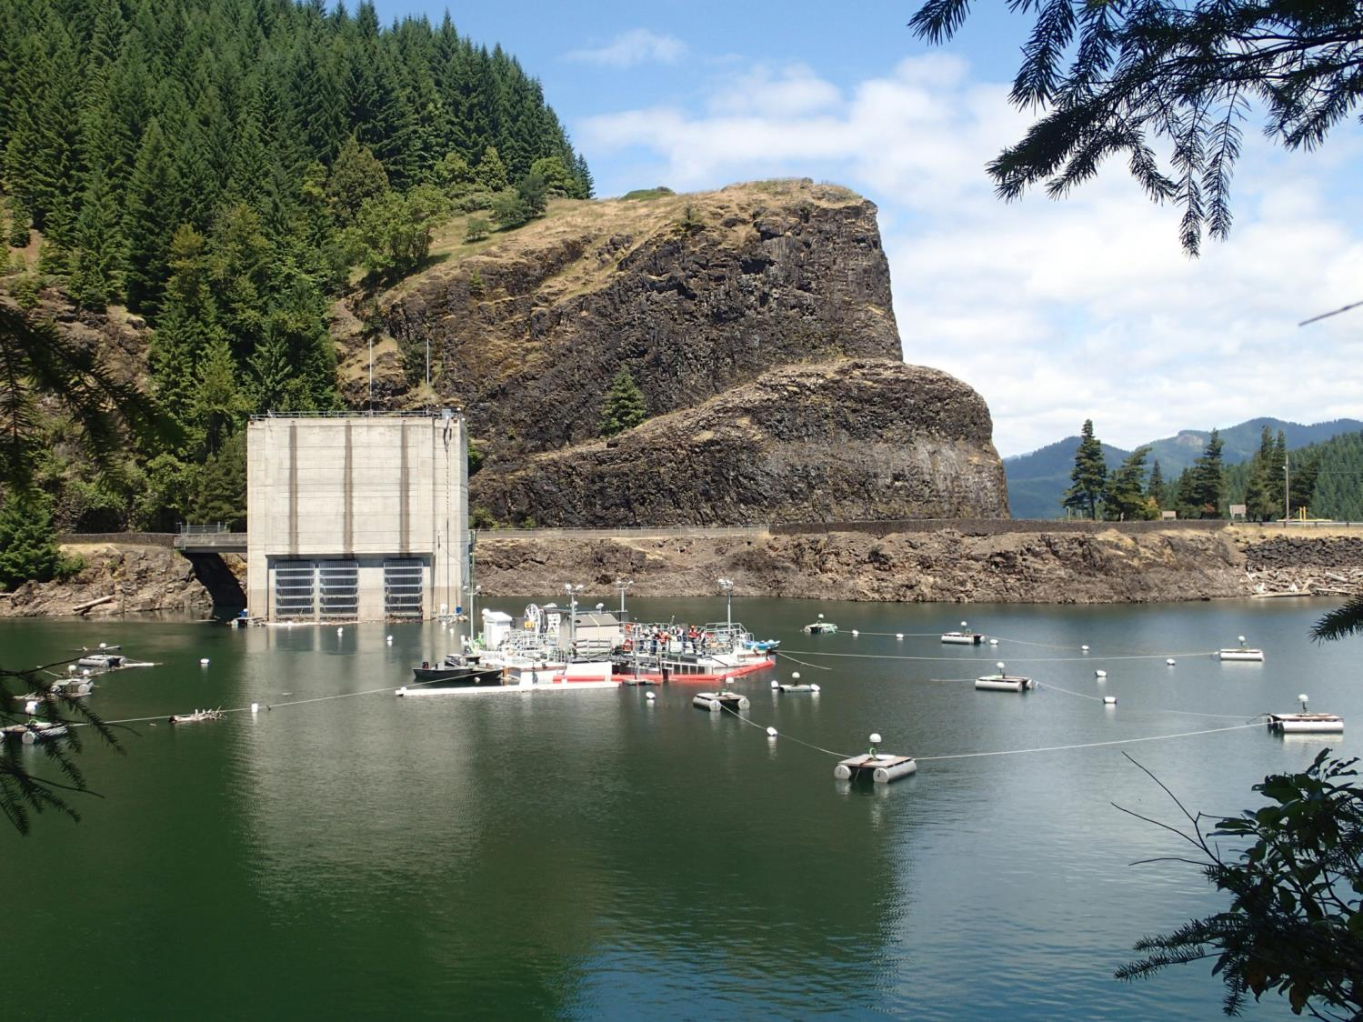

Evaluation of the Cougar Dam PFFC using acoustic telemetry
John Beeman, Hal Hansel, Amy Hansen, Gabriel Hansen, Scott Evans, Philip Haner, Tyson Hatton, Eric Kofoot, Kyle Martens, Jamie Sprando, Matt Sholtis, Collin Smith, Nick Swyers, Noah Adams
USGS, Western Fisheries Research Center
Columbia River Research Laboratory
Cook, WA 98605
U.S. Department of the Interior U.S. Geological Survey
Willamette Review, February 11, 2015

Slide 2
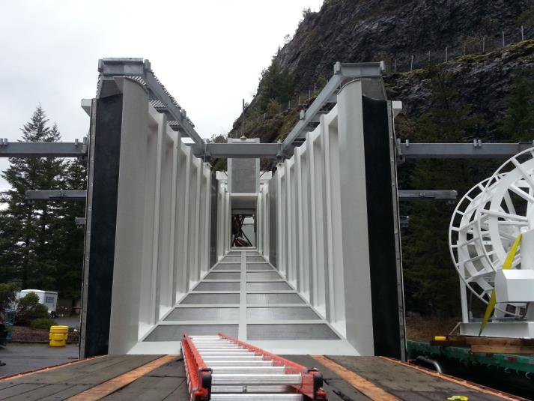
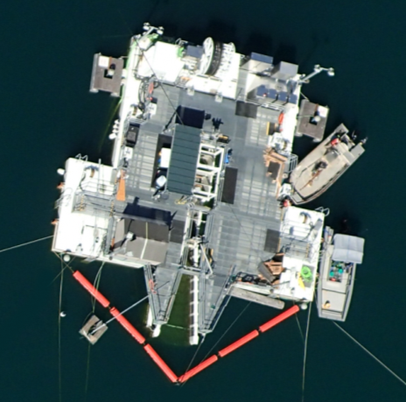
Outline
Study fish, monitoring methods
Numbers collected by PFFC, etc.
3 reasons it did not work better
Summary

Slide 3
Fish and Tags
What
Why
12 mm PIT tags
495 on June 4
1,010 on October 22
Antennas in PFFC and downstream
Acoustic (0.43 g) + PIT tags
434 from April 9 – May 21
(incl. 4 wild)
144 d tag life (90%)
4 hydrophones at forebay log boom, 26 in cul-de-sac, others in tower and downstream
Overall catch of medium-size fish (surrogates)
Spring 65–93 mm FL µ=76.7
Fall 71–180 mm FL µ=154.5
Where, What, When, Why
104–180 mm, µ= 163.6
Mostly surrogates
All fish released near the head of the reservoir

Slide 4
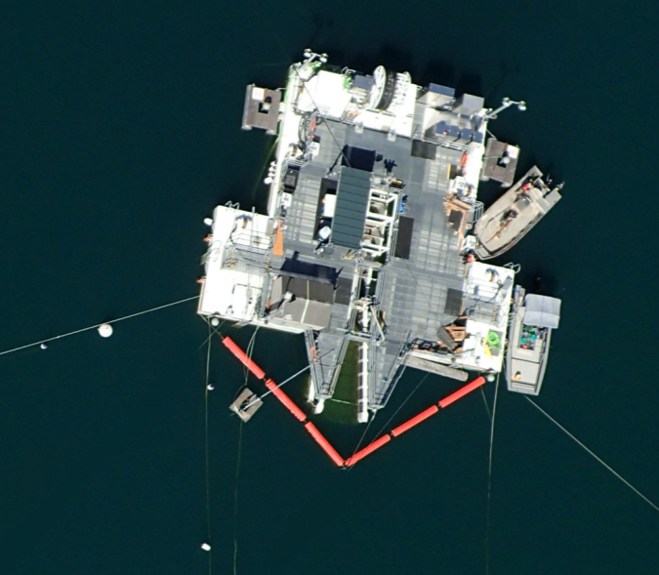
Operating Conditions
Before (5/16 – 5/27)
Low (~50 cfs) or High (~100 cfs) inflow
Randomized block schedule, 5/27-10/28
7-d treatments, 14-d blocks
PIT antenna
~ 3 m
2.7 m
18 m

Slide 5
Metrics (by the numbers)
Travel Percentages
% released reaching forebay log boom
% @ BRZ reaching cul-de-sac
% of those w/ position estimates
% cul-de-sac within 10 m & 1 m of PFFC entrance
Total number captured in PFFC
Capture Efficiency (JSATS+PIT only)
A: PFFC / (PFFC + WTC) ; WTC / (PFFC + WTC)
B: PFFC / # in cul-de-sac; WTC/# in cul-de-sac

Slide 6
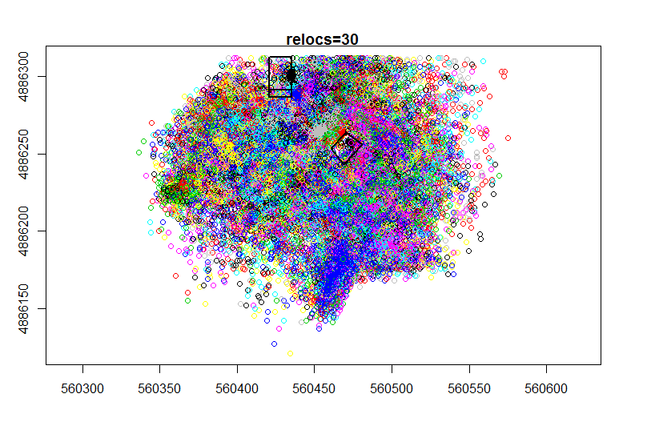
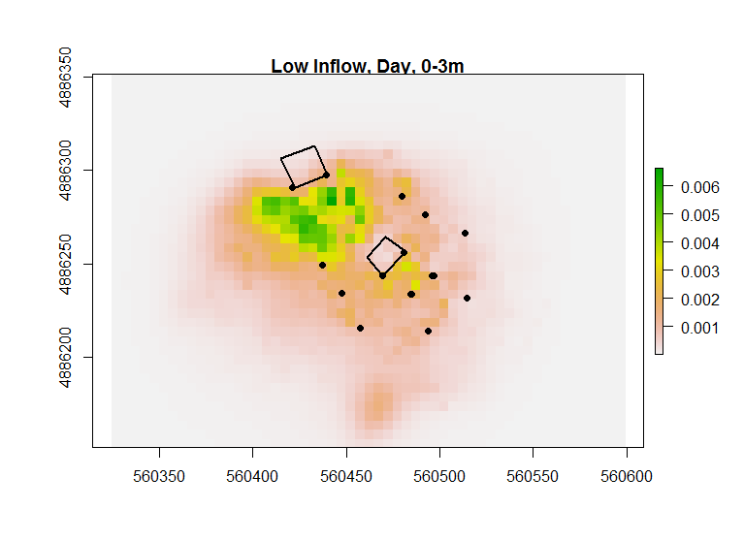
Where Fish Were: Utilization Distributions
Date range May 18 – October 28, 2014
N ≥ 9 obs, gap ≤ 0.5 hour = 1 trip
Dynamic Brownian Bridge Mov. Model
Probability of being in a 5 x 5 m cell
Average within fish, then among fish
Low inflow, daytime, 0-3 m depth
UTM Northing(m)
Low inflow, daytime, 0-3 m depth
Positions to probabilities
N = 129
UTM Easting(m)
Kranstauber et al. 2012. A dynamic Brownian bridge movement
model to estimate utilization distributions for heterogeneous
animal movement. Journal of Animal Ecology 81:738-746.
N = 129
UTM Easting(m)

Slide 7
What: Many Fish Within 10 m, Few Nearer
Category | N | Percent
Released | 434 | --
Detected at Log Boom (in total) | 399 | 91.9
Det. @ Log Boom during PFFC ops | 223 | --
Detected in Cul-de-sac | 214 | 96.0
Positioned in Cul-de-sac | 213 | 99.5
Within 10 m of PFFC (@ 0-3 m deep) | 144 | 67.6
Within 10 m of PFFC (@ 0-6 m deep) | 183 | 85.9
Within 1 m of PFFC (@ 0-3 m deep) | 0 | 0
Within 1 m of PFFC (@ 0-6 m deep) | 11 | 5.2
Total
During PFFC
ops (> 5/27)

Slide 8
What: Few Tagged Fish Collected by PFFC
Category | JSATS + PIT | PIT Only
N Detected in PFFC | 2 | 2
N Captured in PFFC | 1 | 2
N Passing Tower (total) | 42 | na
N Passing Tower (PFFC ops) | 13 | na
Collection Efficiencies
 | Result | Definition
Collection Efficiency (A) | 7.1% (92.9% at tower) | PFFC/(PFFC+Tower)
Collection Efficiency (B) | 0.5% (6% at tower) | PFFC/# in cul-de-sac
*
* = 3 unique fish
Estimated PIT detection probability ~ 95%

Slide 9
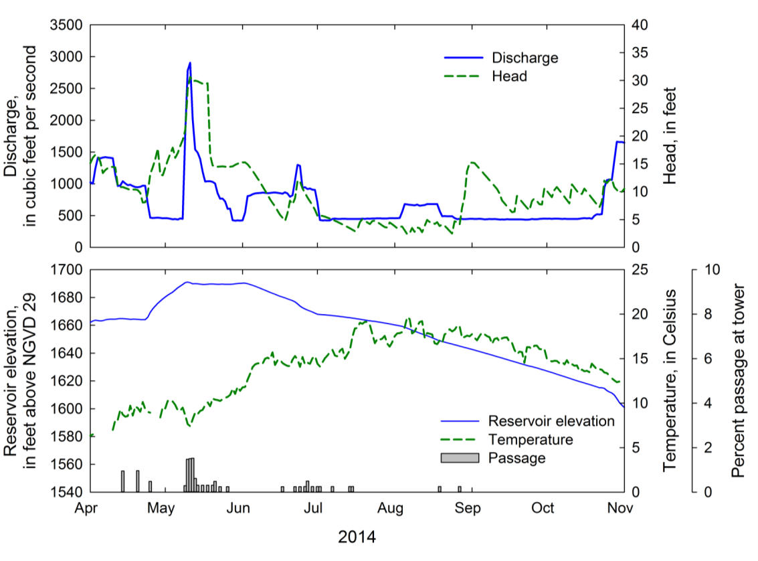
Why #1a: The PFFC OPS Started Late
PFFC OPS BEGAN

Slide 10
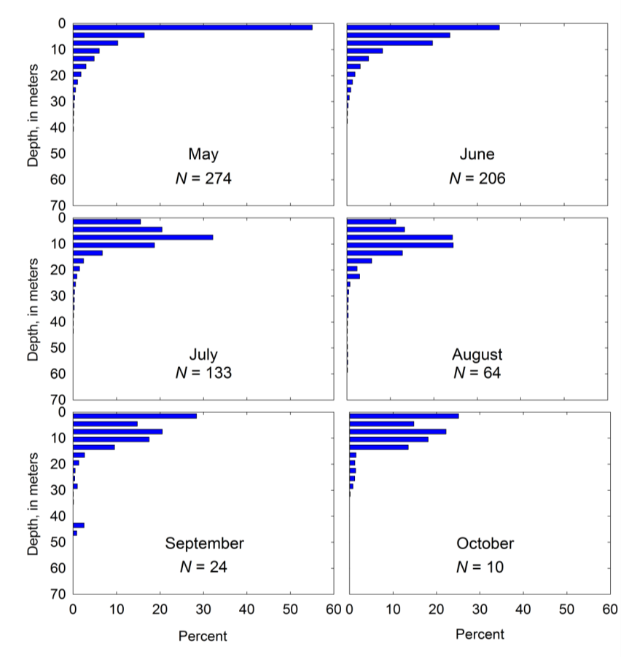
Why #1b: Fish Deeper in Summer
0-3 m = 55%
3-6 m = 16%
0-3 m = 35%
3-6 m = 24%
0-3 m = 16%
3-6 m = 20%
0-3 m = 11%
3-6 m = 13%
0-3 m = 28%
3-6 m = 15%
0-3 m = 25%
3-6 m = 15%
Depths of acoustic-tagged fish in the cul-de-sac

Slide 11
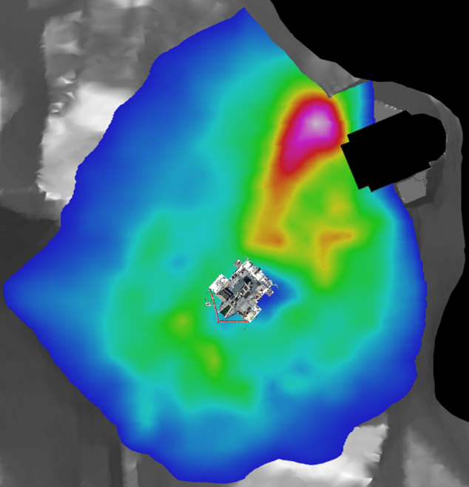
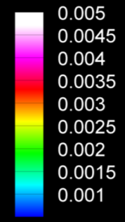
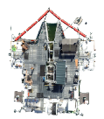
Why #2a: Poor PFFC Location
Low, High,
Day, Night
were similar
Average of Before,
Low, High ops.
Utilization Distribution
0–3 m depth

Slide 12
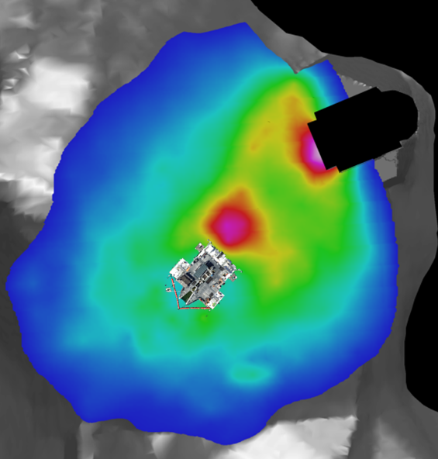
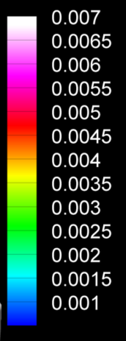
Why #2a: Poor PFFC Location
Low, High,
Day, Night
were similar
Average of Before,
Low, High ops.
Utilization Distribution
3–6 m depth

Slide 13
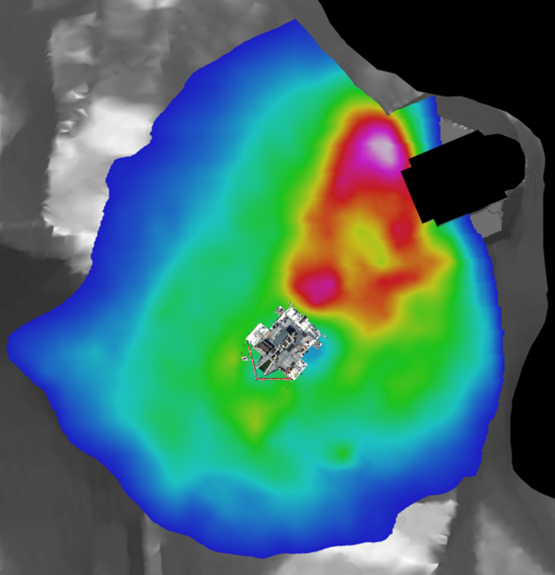
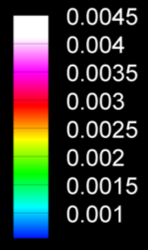
Why #2a: Poor PFFC Location
Low, High,
Day, Night
were similar
Average of Before,
Low, High ops.
Utilization Distribution
0–6 m depth

Slide 14
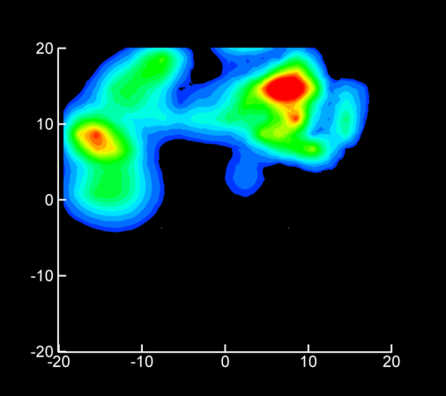
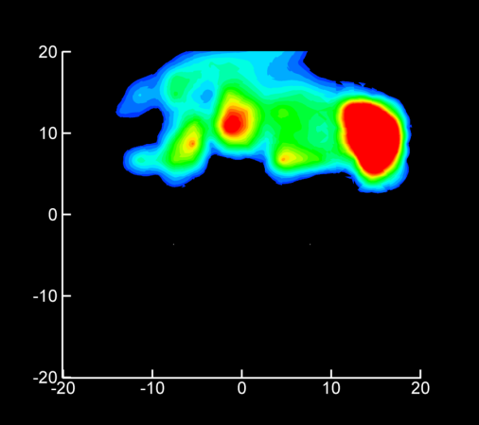
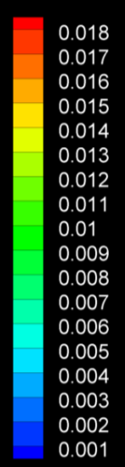
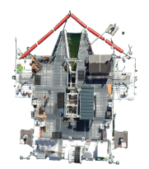
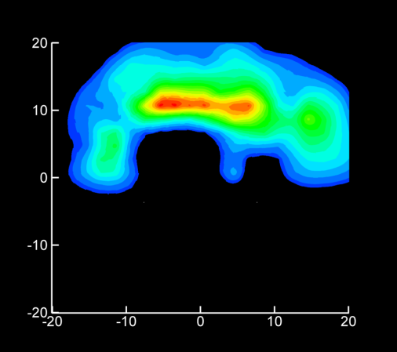
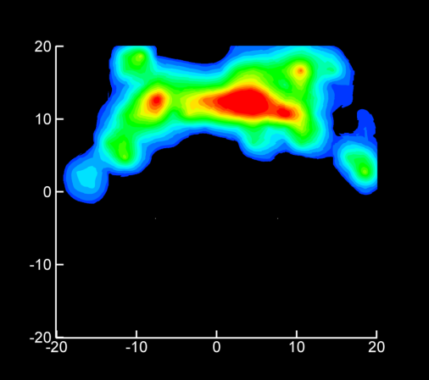
Why #2b: Few Fish near Entrance
Utilization Distributions of fish within a 20 m radius of the PFFC entrance
High Inflow
Day
High Inflow
Night
Low Inflow
Day
Low Inflow
Night

Slide 15
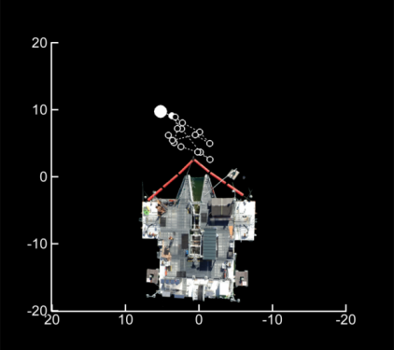
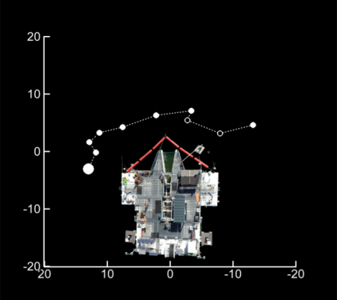
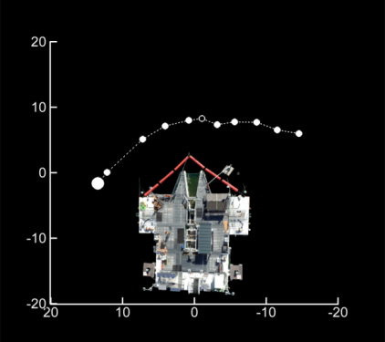
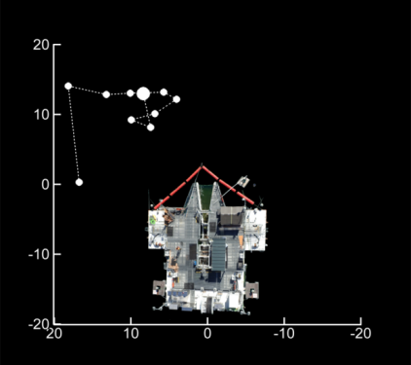
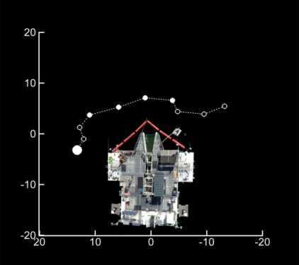
Why #3: Those Nearby Not Attracted
Fish within a 20-m radius of PFFC entrance with ≥ 2 positions within a 10 m radius
Depth <= 3 m
Depth > 3 m
Large circle = start of fish track
Axes = distance (m) from center of PFFC entrance
High Inflow, Day

Slide 16
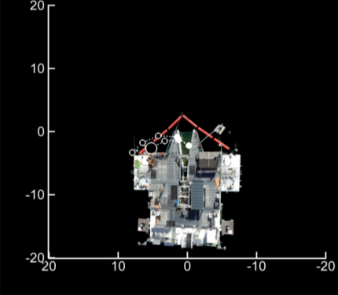
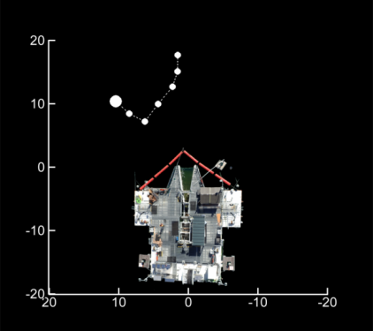
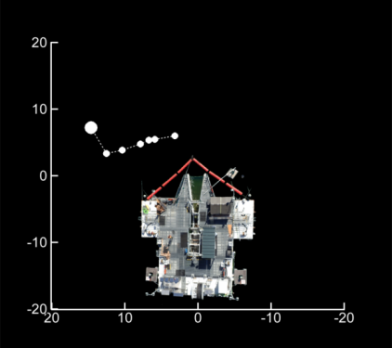
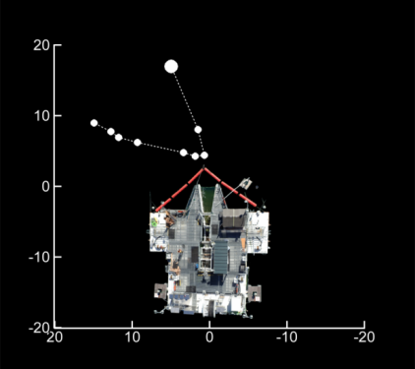
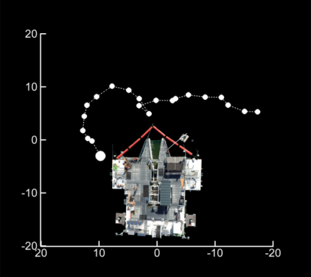
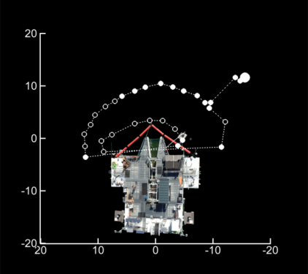
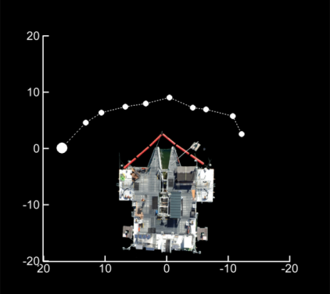

Why #3: Those Nearby Not Attracted
High Inflow, Night

Slide 17
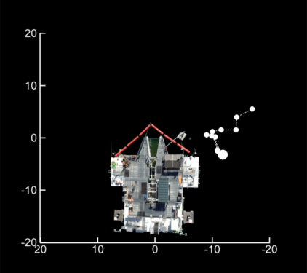
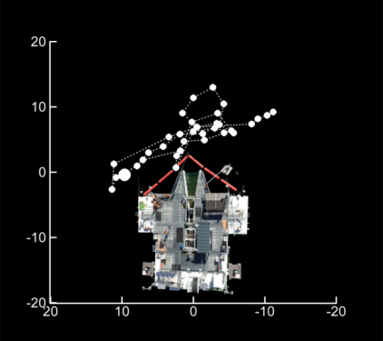
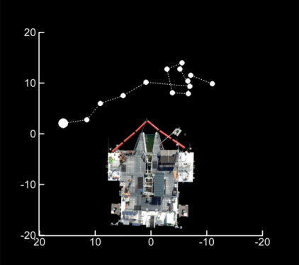
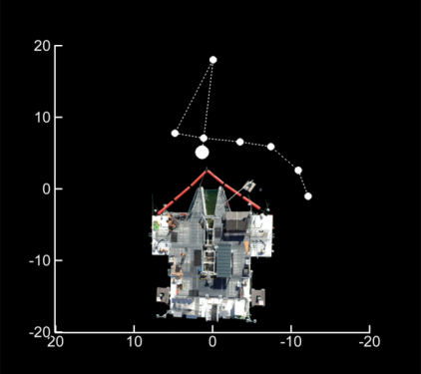
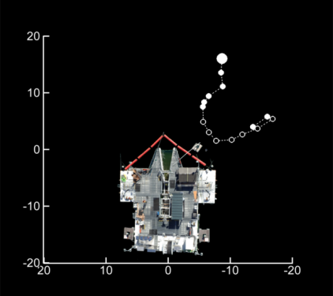
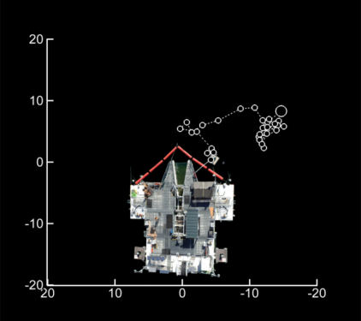
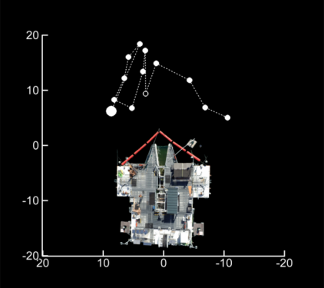
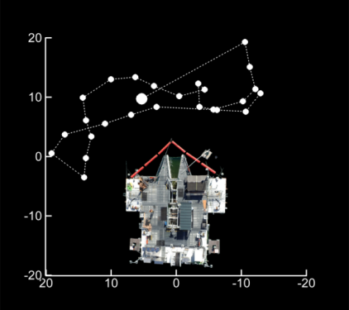
Why #3: Those Nearby Not Attracted
Low Inflow, Day

Slide 18
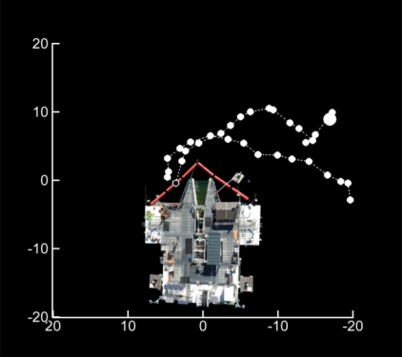
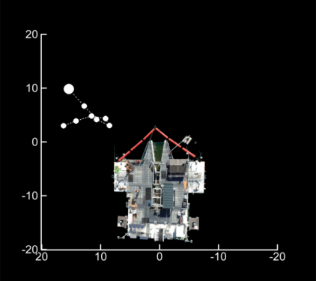
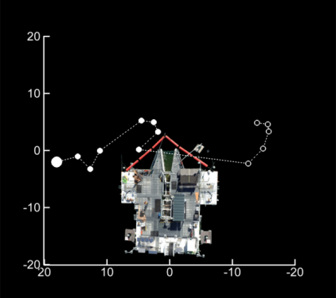
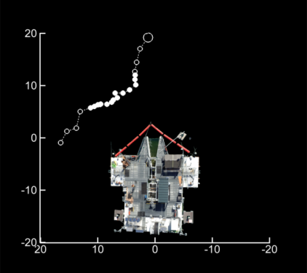
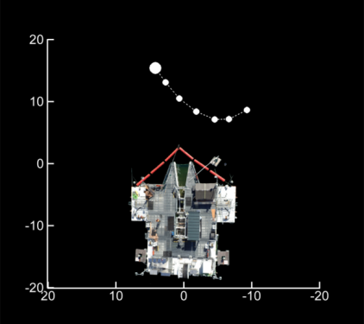
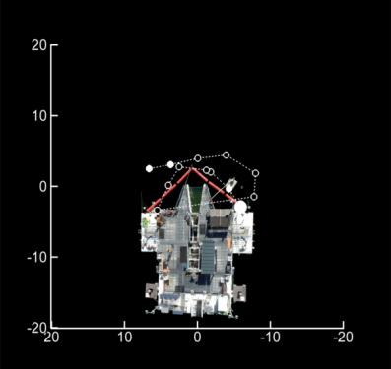
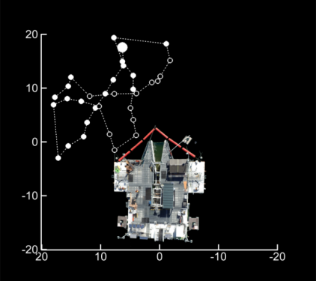
Why #3: Those Nearby Not Attracted
Low Inflow, Night

Slide 19
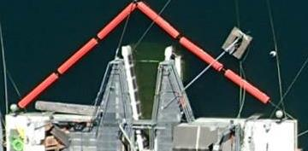



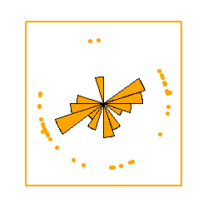









Why #3: Those Nearby Not Attracted
Rose plots indicating headings of fish at 0-3 m depth within a 10 m radius of PFFC entrance
10 m radius
0 – 3m depth
4m
5m
Low Inflow, Day

Slide 20
Summary (1 of 2)
Few fish collected by PFFC
Evidence from tagged fish supports “WHY?” =
Late start
Fish depths unfavorable in summer
Poor location relative to fish locations
Few fish near entrance
Fish nearby not attracted
Few closer than 10 m
Those nearby traveling across rather than towards

Slide 21
Summary (2 of 2)
Corroborating evidence:
Unfavorable inflow velocities (previous presentation)
Rejection within PFFC (next presentation)
Recommendations following modifications
Position based on existing fish and hydraulic data
Continue multi-method evaluation
Uncertainties
Effects of PFFC outflow on fish behavior

Slide 22
Acknowledgements
USACE:
David Griffith, Wes Hively, Andrew Janos, Todd Pierce, Mary Karen Scullion
Wild Fish Surrogate Program
Eric Billman, Rob Chitwood, Karen Cogliati, Carl Schreck
Staff at Leaburg Hatchery
Seth Morgan, Erik Withalm
Eugene Water and Electric Board
USGS staff
Craig Haskell, Glen Holmberg, Russell Perry

